Slide 1

Twitch Data
Analyze Data with SQL
Knox Maclean Bather
September 2023

Slide 2
Table of Contents
1) What are the column names for the Twitch data tables?
2) How many rows are there in the chat and the video_play tables?
3) How many unique users appear in both tables?
4) Show the proportions of only chat users compared to total chat users, and only video_play users compared to total video_play users.
5) Which countries make up the largest proportion of the viewership?
6) Which games are played? Rank them from most viewed to least.
7) Which times have peak and least traffic?
8) How does the ranking of game viewership change throughout the day? Choose the peak, lowest and two times between these times.
9a) How does League of Legend’s viewership change over a 24-hour period?
9b) Does the top locations of League of Legend’s viewers change over the course of the day?
10) How many channels are there, and which is the most popular? Also work out their subscribers.

Slide 3
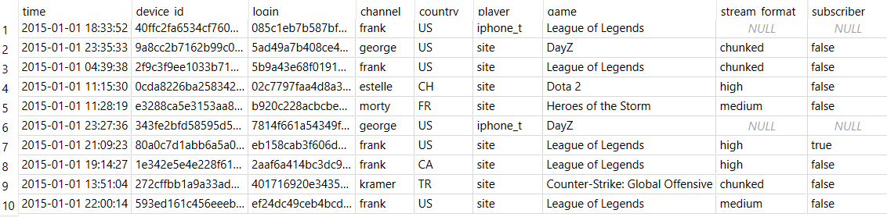
Q1. What are the column names for the Twitch data tables?
CODE
select *
from video_play
limit 10;
select *
from chat
limit 10;
Video_play Table:
Time
device_id
login
channel
country
player
game
stream_format
subscriber
Chat Table:
Time
Device_id
Login
Channel
Country
Player
Game

Slide 4
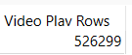
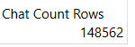
Q2. How many rows are there in the chat and the video_play tables?
CODE
select count(*) as 'Video Play Rows'
from video_play;
select count(*) as 'Chat Count Rows'
from chat;

Slide 5
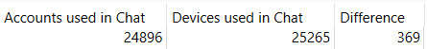
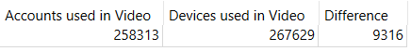
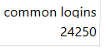
Q3. How many unique users appear in both tables?
There is a large difference between the amount of people who are streaming on twitch and the number using the chat function. Only ~9.5% of people use the chat function (9.6% according to accounts used and 9.4% according to devices used).
There is a large cross over between the two tables with 24,250 common logins being recorded in both the video_play and chat tables.
It is surprising that this number is smaller than the unique logins recorded in the chat table which suggests that a small number of people (~650 people) use the chat function without watching a stream.
Note of Interest: The difference between account and device numbers suggest that a small portion of users are logged in on multiple devices. This difference may be reduced by people with multiple accounts.
CODE
select count(distinct login) as 'Accounts used in Chat’,
count(distinct device_id) as 'Devices used in Chat’,
(count(distinct device_id) - count(distinct login)) as 'Difference'
from chat;
select count(distinct login) as 'Accounts used in Video’,
count(distinct device_id) as 'Devices used in Video’,
(count(distinct device_id) - count(distinct login)) as 'Difference'
from video_play ;
select count(distinct login) as 'common logins'
from video_play
where login in (
select login
from chat);

Slide 6
Q4. Show the proportions of only chat users compared to total chat users and only video_play users compared to total video_play users.
Using the previous figures (shown right) we can find the proportions of how people use twitch.
We will use the figures from ‘Accounts’ (highlighted yellow) for these calculations as the larger devices_id numbers suggests some users login on multiple devices making duplicate values.
Only chat users / total chat users = 2.59%
Only chat users / total streamers = 0.25%
Non-chat streamers / total streamers = 90.4%

Slide 7
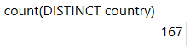
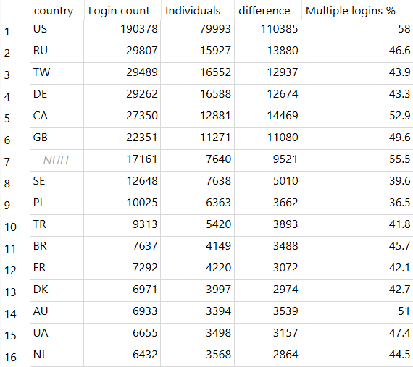
Q5. Which countries make up the largest proportion of the viewership?
There are 167 unique countries in the video_play table [code 1].
By viewership, the US is the largest country by a significant margin for both the number of logins (190,378) and individuals (79,993) using the platform with 58.0% of users logging in multiple times.
The next five (RU, TW, DE, CA, and GB respectively) have similar in logins to each other ranging from 29,807 – 22,351, very far from the US’s numbers.
- The ‘NULL’ row is a large number of logins that have not been linked to a country. Given the extensive list of countries already identified we can assume these logins are mostly made up of countries on the list. It is likely that a large proportion of these 17,161 logins are from the US given the country’s extensive numbers.
CODE
1) select count(distinct country)
from video_play
where country is not null
order by country asc;
2) select country, count(login) as 'Login count', count(distinct login) as 'Individuals’,
count(login) - count(distinct login) as 'difference',
round(100.0*(count(login) - count(distinct login)) / count(login), 1) as 'Multiple logins %'
from video_play
group by 1
order by 2 desc;

Slide 8
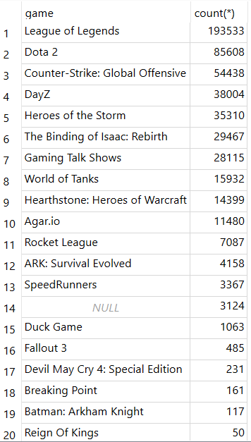
Q6. Which games are played? Rank them from most viewed to least.
League of Legends is by far the most streamed game with 193533 data rows linked to the game.
Dota 2 is the second most poular with 85,608 views
Counter-strike is third with 54,438.
- These top three games have been highlighted blue, orange and red, respectively.
CODE
select distinct game, count(*)
from video_play
group by 1
order by 2 desc;

Slide 9
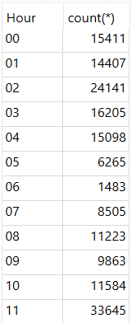
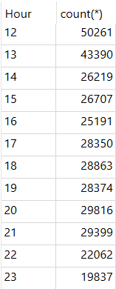
Q7. Which times have peak and least traffic?
Peak traffic time = 12:00 – 12:59 pm
Lowest traffic time = 06:00 – 06:59 am
Noon is the peak time for traffic with views scaling up quickly from 11am to 12pm before trailing down in viewership over the afternoon. This slow decline in viewership continues well into the night with a small peak at 2:00 before dropping suddenly at 5:00 and leading to the 6am trough.
Lowest Viewership
Highest Viewership
CODE
select strftime('%H', time) as 'Hour’, count(*)
from video_play
group by 1
order by 1
;

Slide 10
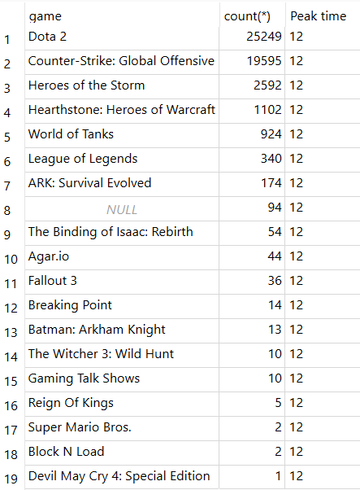
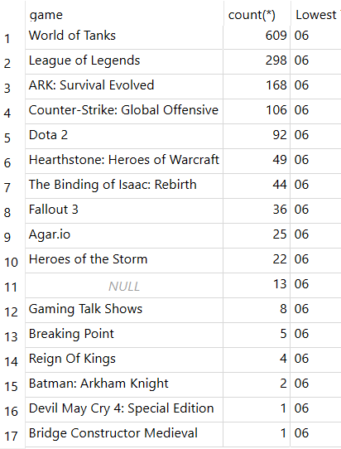
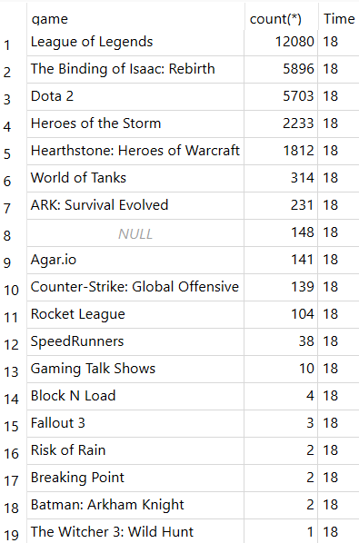
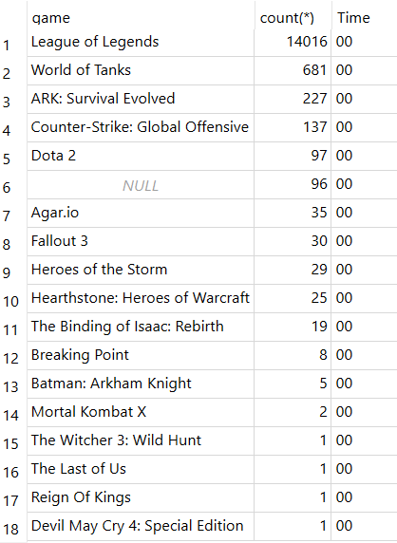
Q8. How does the ranking of game viewership change throughout the day? Choose the peak, lowest and two times between these times.
Using peak time (12pm), lowest traffic time (6am) and two other times – 18:00 and 24:00.
A similar code (right) was used, varying the highlighted part for the numbers 12, 06, 18, 00 and appropriate descriptions.
Surprisingly, the most viewed game overall (LoL) does not have much of an audience during peak time. It’s audience peaks in the afternoon and at night suggesting this may be to do with viewership locations/ work culture.
select distinct game, count(*), strftime('%H', time) as ‘Peak time’
from video_play
where strftime('%H', time) = '12'
group by 1
order by 2 desc;

Slide 11
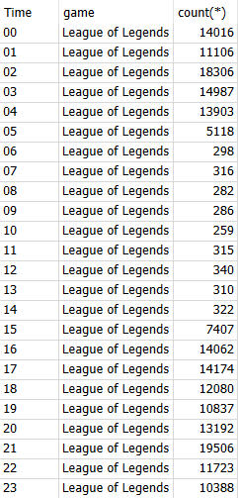
Q9a. How does League of Legend’s viewership change over a 24-hour period?
League of Legend viewership maintains a high count from the afternoon to the earlier hours of the morning [16:00 to 04:00]. This time range has been highlighted with the green lines.
There are two noticeable peak times, the highest of these is at 21:00 with 19,506 views (indicated with a green arrow) the other is just smaller at 02:00 with 18,306 views.
The times of lowest viewership are between 06:00 and 14:00, these have been highlighted with a red line, and the hour of least views is at 10:00 with just 259 views (indicated with red arrow).
These peak and least timings appear to correlate with standard working hours, perhaps the location of viewership will indicate further correlation.
Lowest Viewership
CODE
select strftime('%H', time) as 'Time', game, count(*)
from video_play
where game like 'League%'
group by 1
order by 1;
Highest Viewership

Slide 12
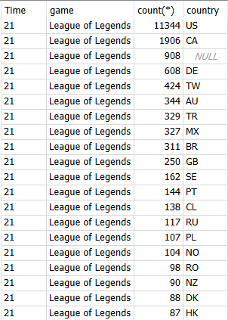
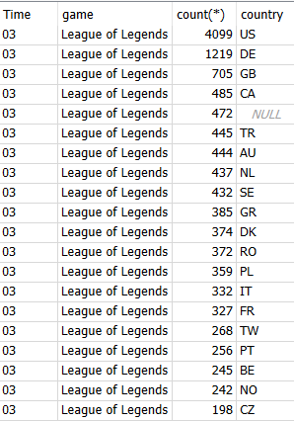
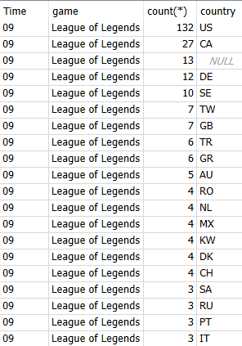
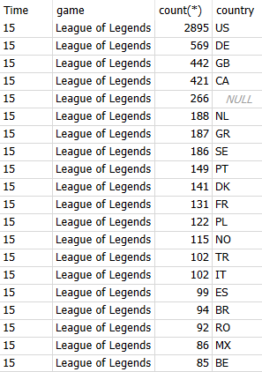
Q9b. Does the top locations of League of Legend’s viewers change over the course of the day?
Taking the peak time and every 6 hours after that [21:00, 03:00, 09:00 and 15:00]
It can clearly be seen that the US has the greatest influence over viewership number, far out numbering any other country at all times of the day. The fact that viewership peaks outside of standard work hours and is lowest during them, lead us to the conclusion that the US working day has a large influence on the number of views a channel might get.
CODE
select strftime('%H', time) as 'Time', game, count(*), country
from video_play
where game like 'League%' and strftime('%H', time) = '15'
group by 4
order by 3 desc
limit 20;

Slide 13
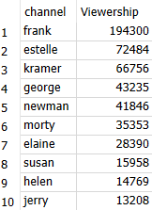
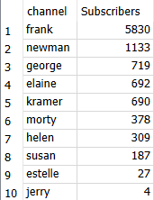
Q10. How many channels are there, and which is the most popular? Also work out their subscribers.
The largest channel is Frank with a massive 194300 viewers and 5830 subscribers.
The others are not spread as far apart in viewers with Estell second largest with 72484 viewers and then Karmer with 66756 viewers.
However, with the first and second queries we can see that more viewers does not necessarily translate to more subscribers. Frank is the only exception to this but his subscriber number is still very small relative to his viewership.
A)
B)
CODE
A) select channel, count(*)
from video_play
group by 1
order by 2 desc;
B) select channel, count(*) as ‘Subscribers’
from video_play
where subscriber = 'true’
group by 1
order by 2 desc;

